Slide 1
Customer churn prediction
Machine Learning Model
Data Analysis Project
Presented by: Navya Khandelwal Tools Used: Python, Pandas, Matplotlib, Seaborn, Sklearn

Slide 2
Problem Statement
Goal: To predict whether a customer will churn (leave) the telecom company.
Why it matters:
Acquiring new customers is 5 times more expensive for a company than retaining existing ones.
Understanding churn helps businesses improve customer retention and thus reduce losses.

Slide 3
Dataset Overview
Source: Telco Customer Churn Dataset
Rows: 7043 customers
Features: 21 (demographic, service, account information)
Target: Churn (yes/no)

Slide 4
Data Pre-processing
✔ Checked for null values and duplicates ✔ Converted total charges to numeric ✔ One-hot encoded categorical features ✔ Standardized numerical columns

Slide 5
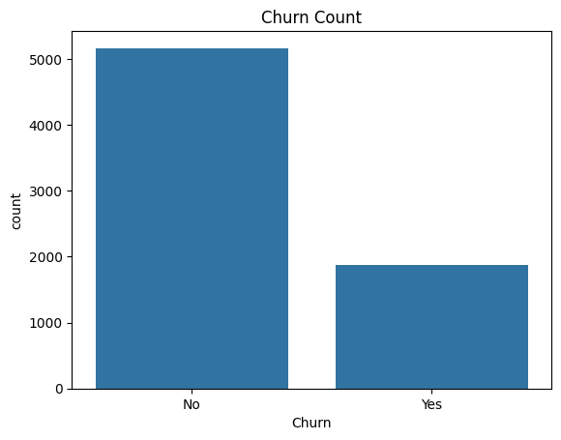
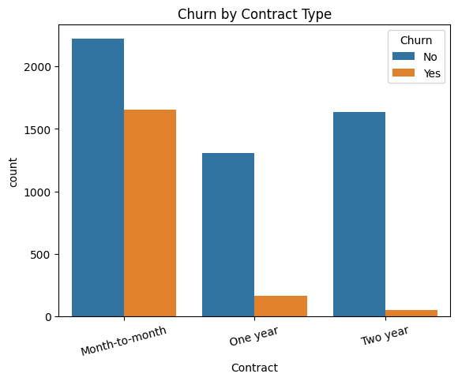
Exploratory Data Analysis
Customers with month-to-month contracts churn the most
Churn Rate: ~26.5%

Slide 6
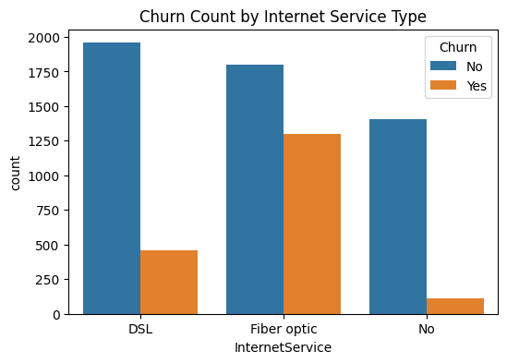
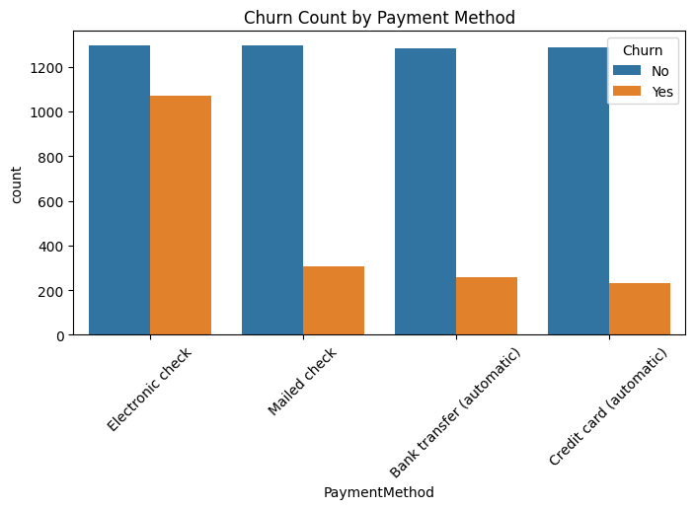
Churn is higher among customers:
With electronic check payments
With fiber optic internet
Without online security or tech support

Slide 7
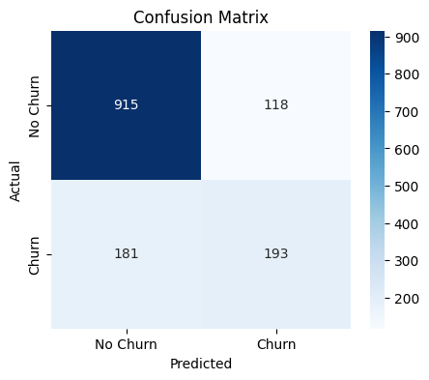
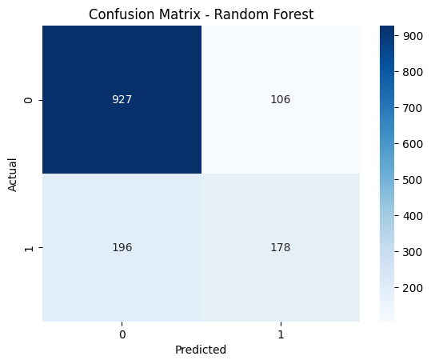
Model Selection & Training
LOGISTIC REGRESSION
RANDOM FOREST CLASSIFIER
Accuracy: 78.75 %
ROC AUC Score: 78.00%
Accuracy: 78.53 %
ROC AUC Score: 81.62%

Slide 8
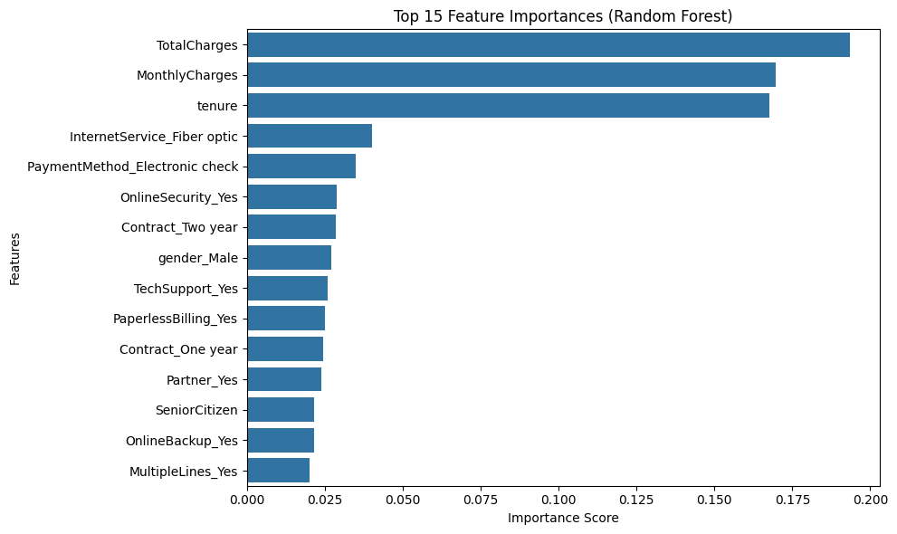
Feature Importance
Model Used: Random Forest Classifier
Top Features Affecting Churn:
Total Charges
Monthly Charges
Tenure
Fiber Optic Internet
Electronic Check
Online Security
Contract Type

Slide 9
Business Insights & Recommendations
Customers with month-to-month contracts and no online security are more likely to churn
Encouraging long-term contracts and bundled services reduces churn
Fiber optic users may leave due to cost , thus we should explore pricing strategies
RECCOMENDATIONS:
Deploy the model using Flask or Streamlit
Apply Customer Segmentation for personalized retention strategies
Use Real Time Churn Prediction on new data

Slide 10
THANK YOU

